Slide 1
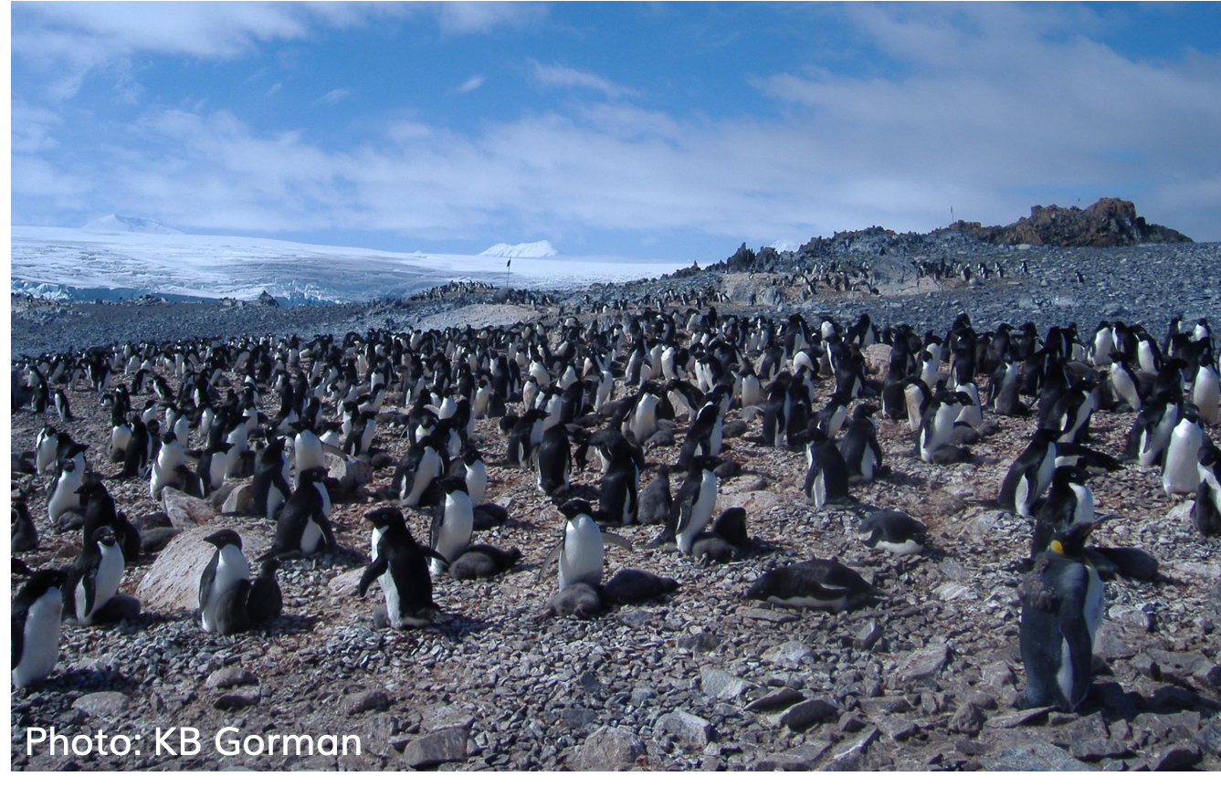
PENGUIN SIZES DATASET
An analysis of penguin species and locations
Adélie penguins raising chicks at Torgersen Island.
Adélie penguins raising chicks at Torgersen Island

Slide 2
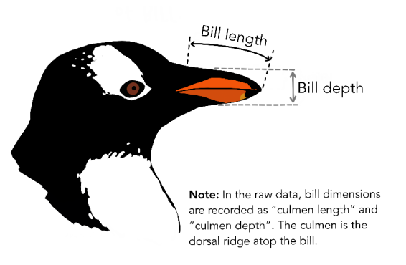
Checking the data
df.head()
 | species | island | culmen_ length_mm | culmen_depth_mm | flipper_ length_mm | body_ mass_g | sex
0 | Adelie | Torgersen | 39.1 | 18.7 | 181.0 | 3750.0 | MALE
1 | Adelie | Torgersen | 39.5 | 17.4 | 186.0 | 3800.0 | FEMALE
2 | Adelie | Torgersen | 40.3 | 18.0 | 195.0 | 3250.0 | FEMALE
3 | Adelie | Torgersen | NaN | NaN | NaN | NaN | NaN
4 | Adelie | Torgersen | 36.7 | 19.3 | 193.0 | 3450.0 | FEMALE
Data
Species - Penguin species
Island - Island the penguin belongs to
Culmen_Length_mm - length of the penguins bill
Culmen_Depth_mm - depth of the penguins bill
Flipper_Length_mm - flipper length of the penguin
Body_Mass_g - Body mass of the penguin
Sex - Gender of the penguin

Slide 3
Cleaning the data
df.info()
<class 'pandas.core.frame.DataFrame’>
RangeIndex: 344 entries, 0 to 343 Data columns (total 7 columns):
# Column Non-Null Count Dtype
--- ------ -------------- -----
0 species 344 non-null object
1 island 344 non-null object
2 culmen_length_mm 342 non-null float64
3 culmen_depth_mm 342 non-null float64
4 flipper_length_mm 342 non-null float64
5 body_mass_g 342 non-null float64
6 sex 334 non-null object
dtypes: float64(4), object(3)
memory usage: 18.9+ KB
Check the data: 344 rows, 7 columns
10 rows with no data and also a full stop
Decision to replace all empty fields with an average or remove the rows
Replaced the full stop with a null entry and removed all null entries. This was 3%

Slide 4
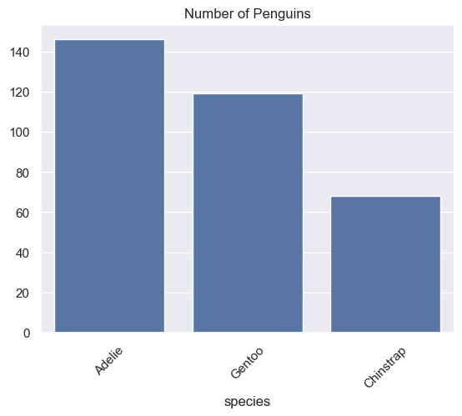
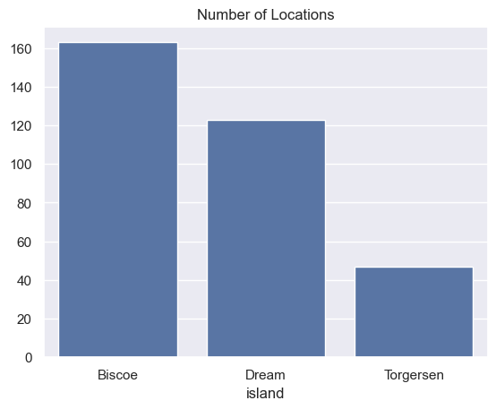
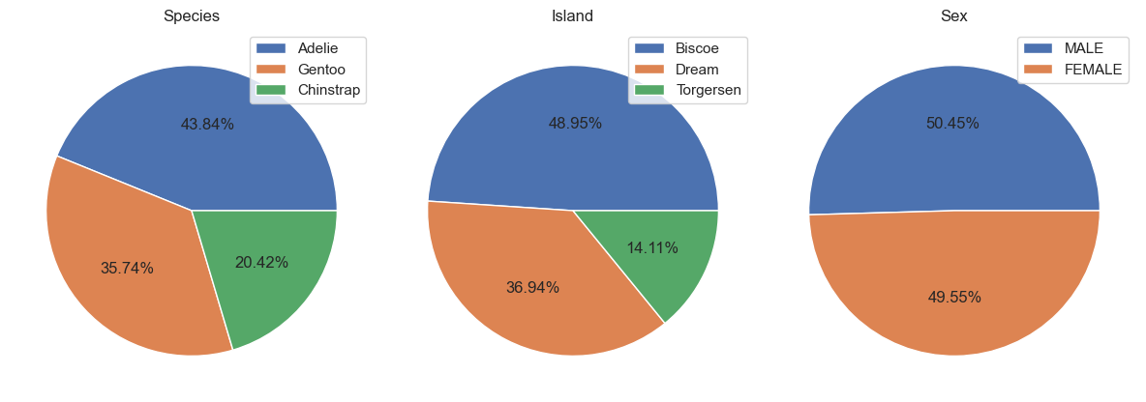
Species and Locations
species
Adelie 146
Gentoo 119
Chinstrap 68
island
Biscoe 163
Dream 123
Torgersen 47

Slide 5
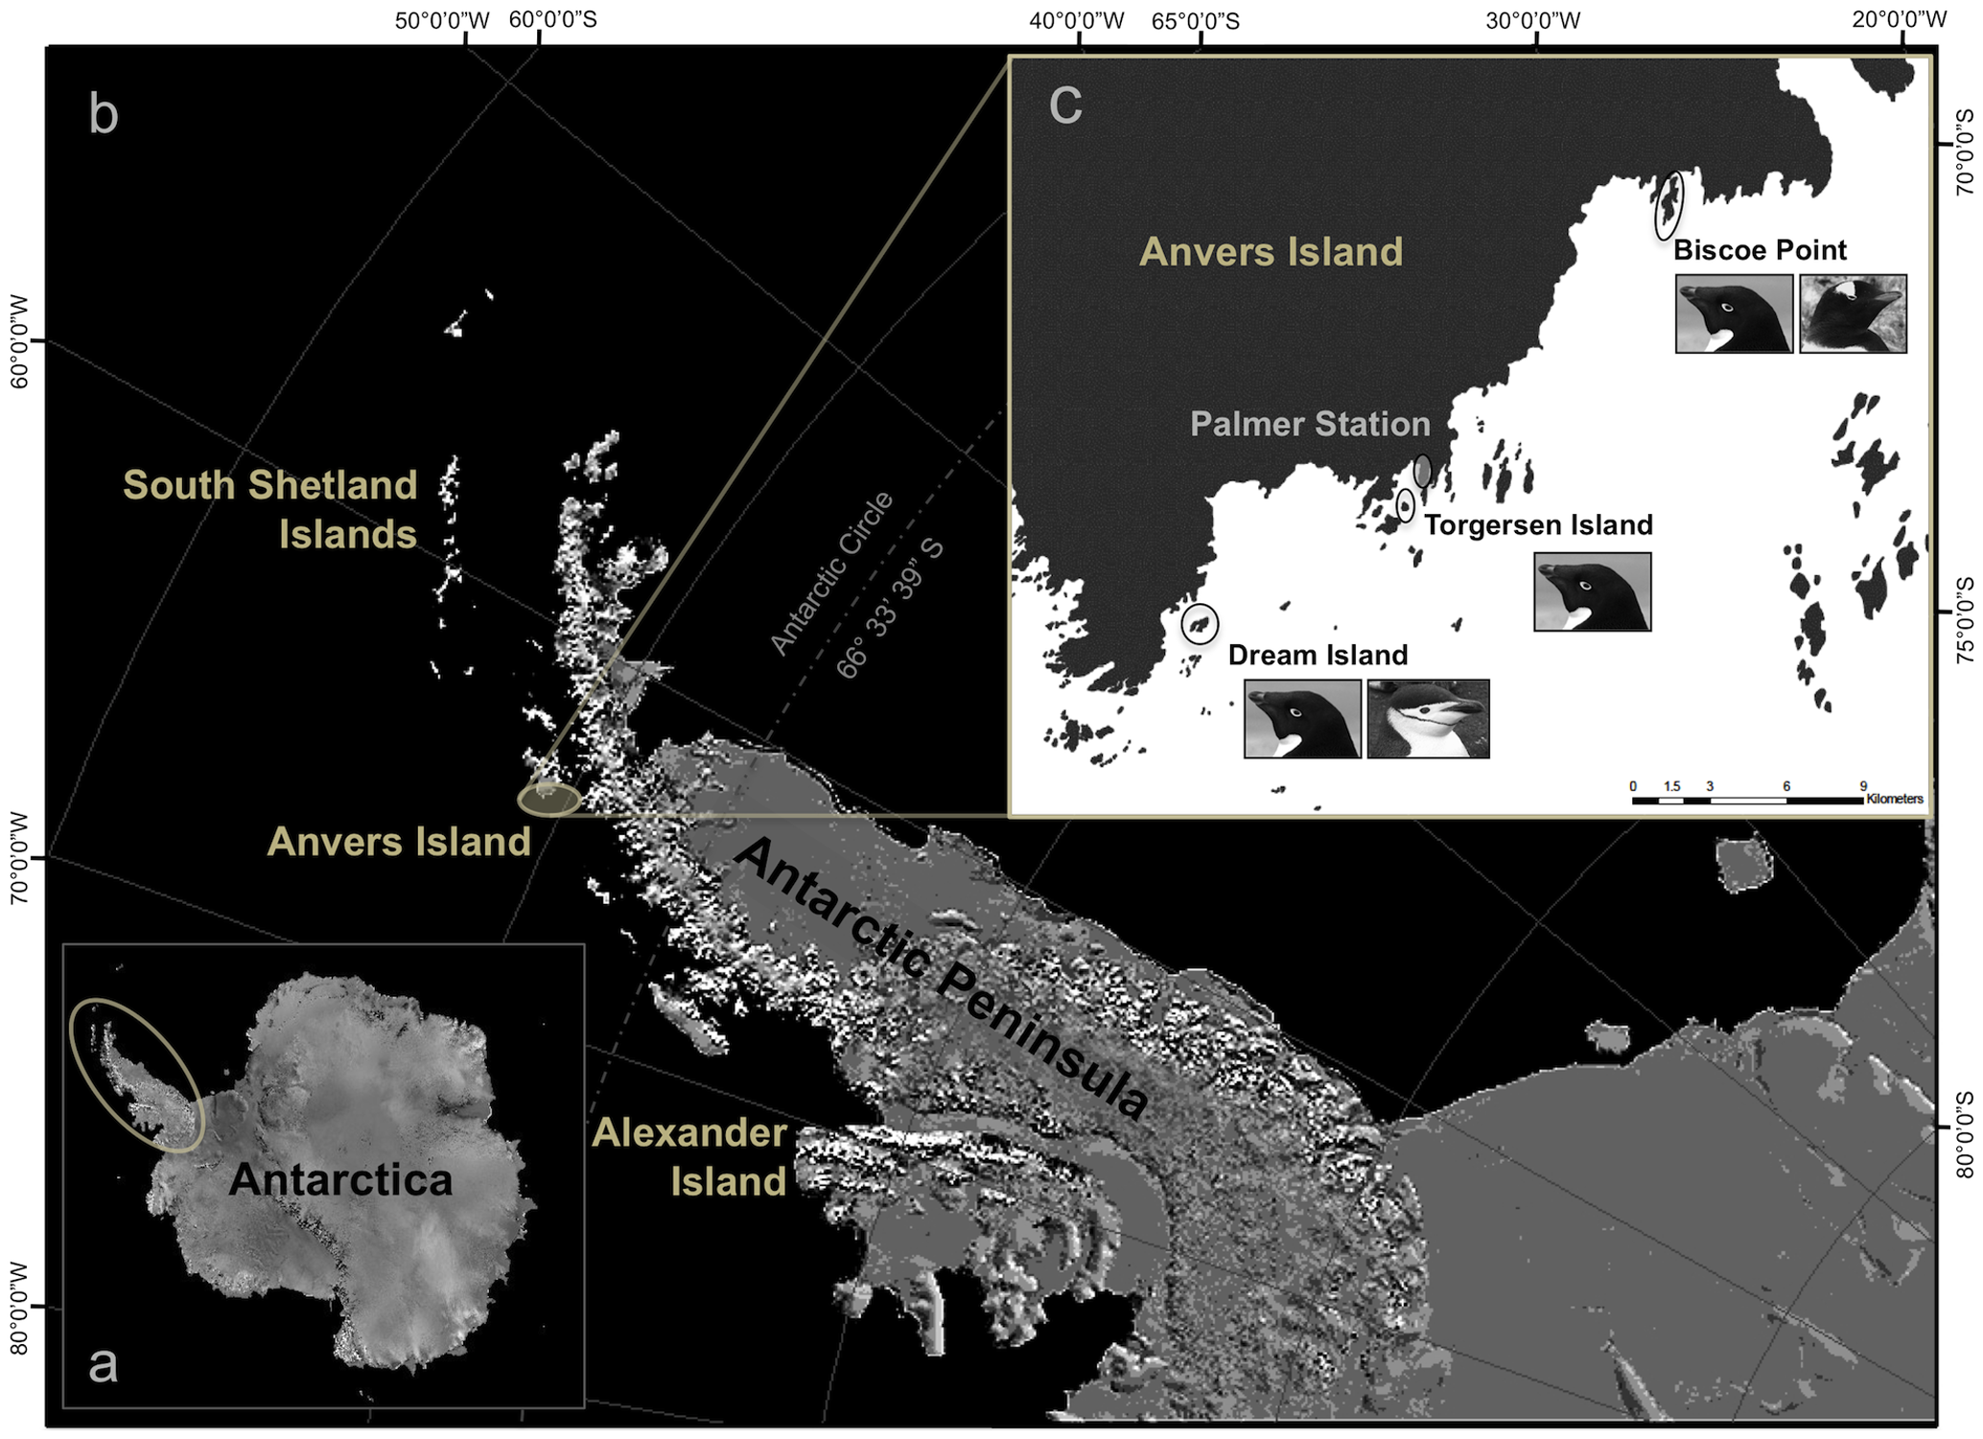
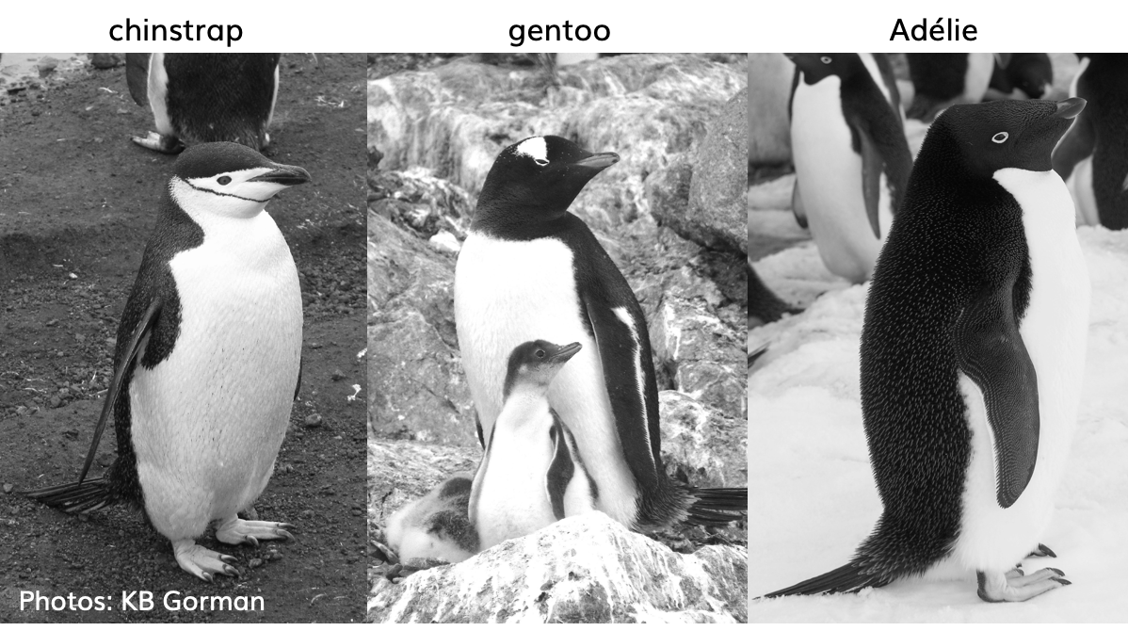
Penguin species and area of Study
Chinstrap Gentoo Adelié
Data and original study in 2007 -2009 collected and made available by Dr. Kristen Gorman and the Palmer Station, Antartica LTER
Image generated from base maps provided by the National Snow and Ice Data Centre's map server A-CAP.

Slide 6
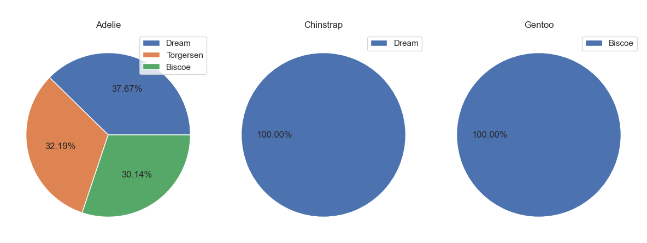
Penguin species and population on each island
Dream | Torgersen | Biscoe
Adelie 55 | Adelie 47 | Adelie 44
Chinstrap 68 |  | Gentoo 119
123 | 47 | 163

Slide 7
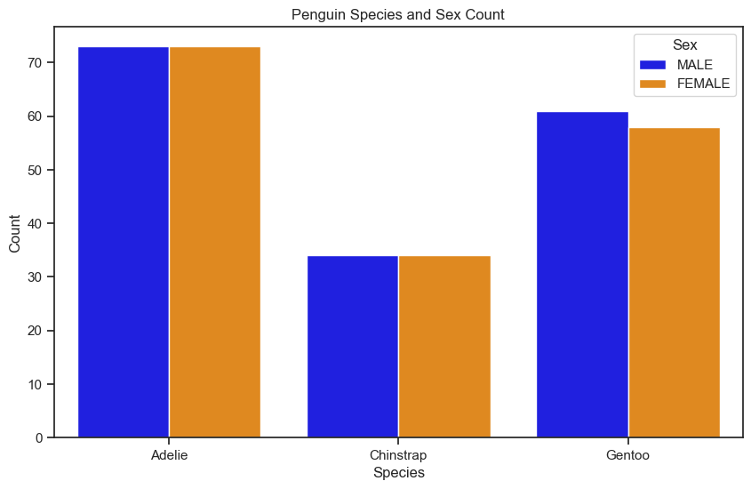
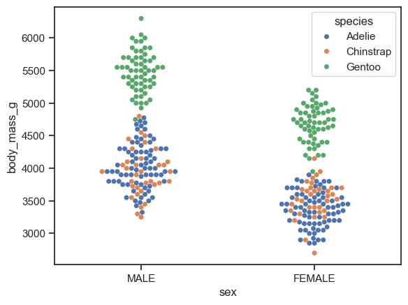
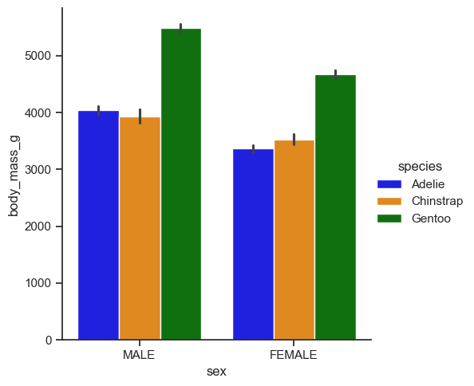
Penguin sex and body mass sizes
Penguin species and sex count
Male and female body mass sizes on a barchart and swarmplot
sex
MALE 168
FEMALE 165

Slide 8
Description of the dataset
df.describe()
 | culmen_length_mm | culmen_depth_mm | flipper_length_mm | body_mass_g
count | 333.000000 | 333.000000 | 333.000000 | 333.000000
mean | 43.992793 | 17.164865 | 200.966967 | 4207.057057
std | 5.468668 | 1.969235 | 14.015765 | 805.215802
min | 32.100000 | 13.100000 | 172.000000 | 2700.000000
25% | 39.500000 | 15.600000 | 190.000000 | 3550.000000
50% | 44.500000 | 17.300000 | 197.000000 | 4050.000000
75% | 48.600000 | 18.700000 | 213.000000 | 4775.000000
max | 59.600000 | 21.500000 | 231.000000 | 6300.000000

Slide 9
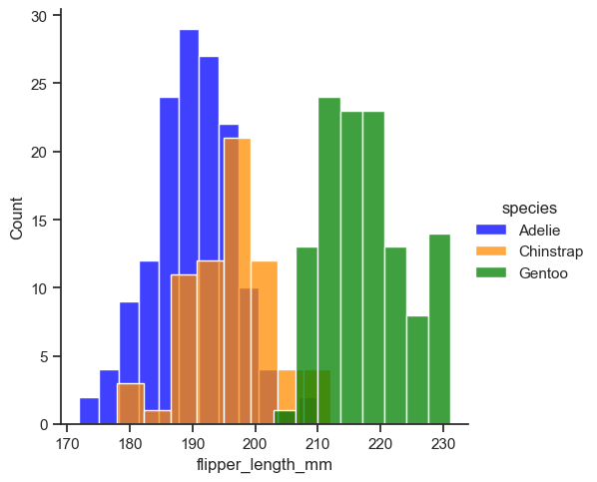
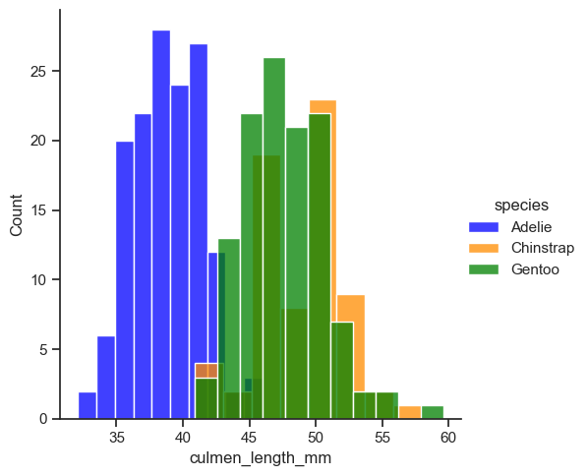
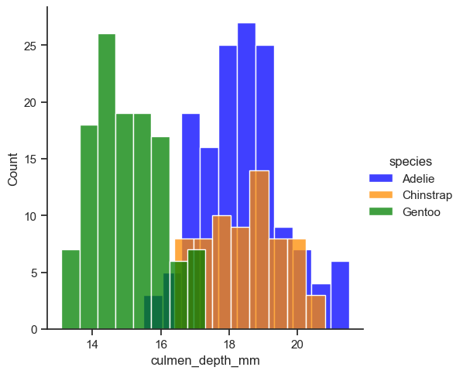
Penguin flipper and culmen sizes
Flipper length
Culmen length
Culmen depth

Slide 10
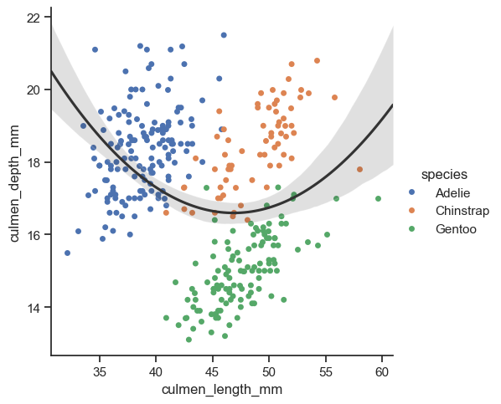
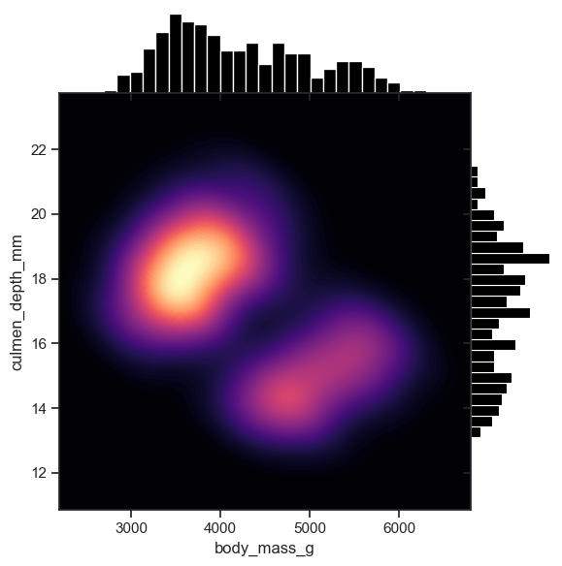
Comments and insights
There are 3 species of penguins and 3 islands.
The Adelie’ reside on all 3, the Chinstraps on Dream Island and the Gentoo’s on Biscoe Island. This leaves Torgesen to only have Adeliés.
There are a similar number of males and females in each group.
The Gentoo’s are the larger of the species, with the Chinstraps and Adelie’s being of similar size.
The Gentoo’s flippers have the longest length, then Chinstraps with the Adelie’s overlapping but generally shorter.
The Chinstraps have long and deep culmens, the Gentoo’s are long and narrow and the Adelie’s are shorter and deeper.

Slide 11
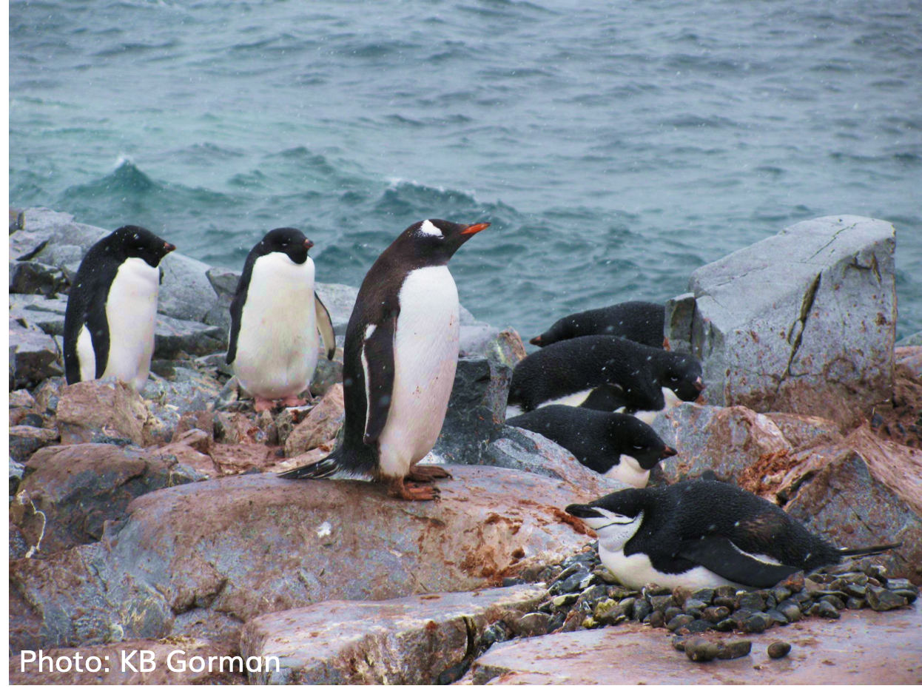
Thank you for listening
Any Questions?
Adélie, gentoo and chinstrap penguins!
Photo: K. Gorman.

Slide 12
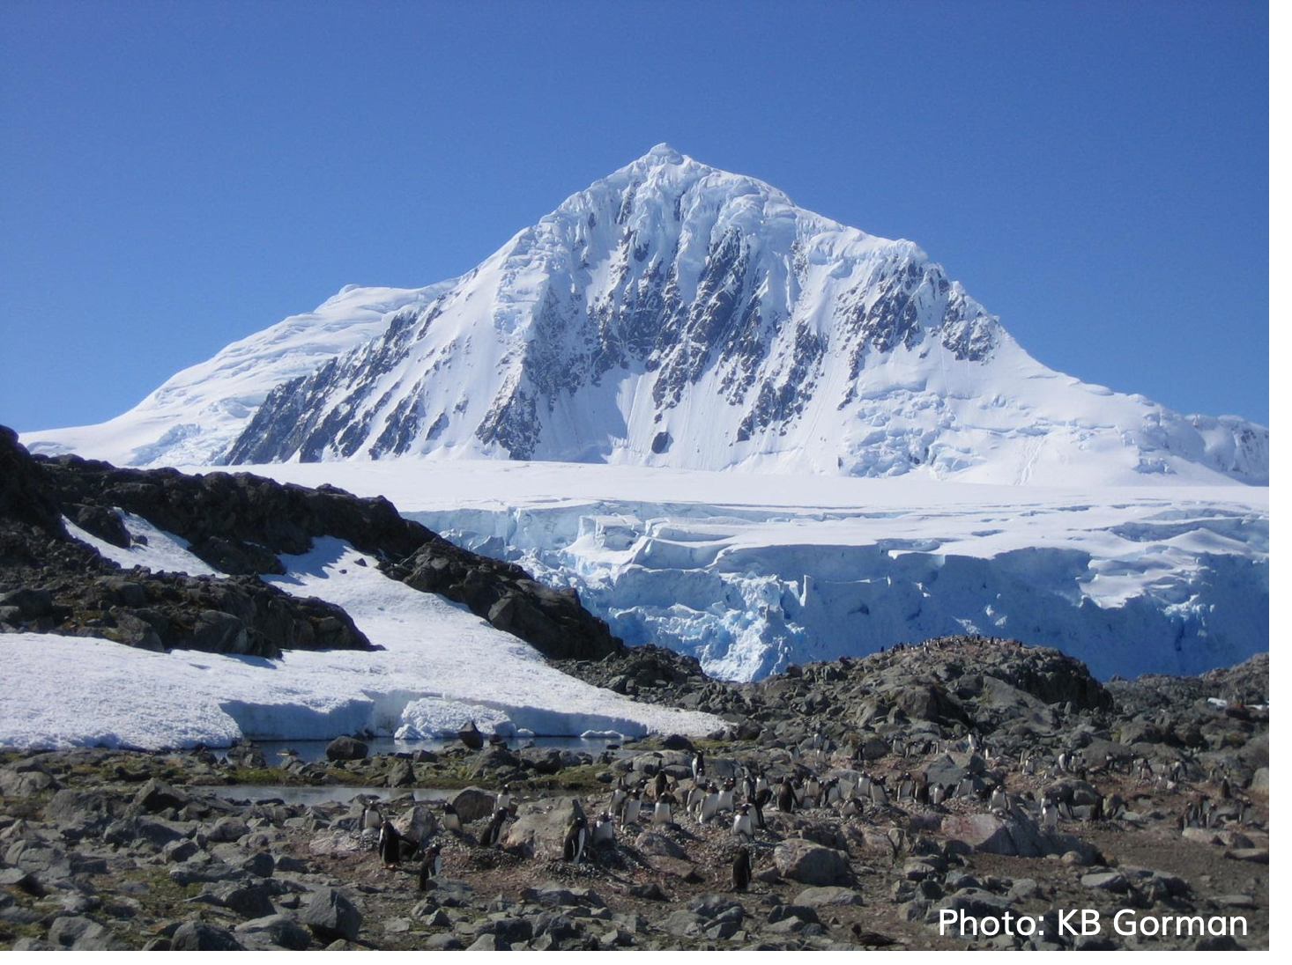
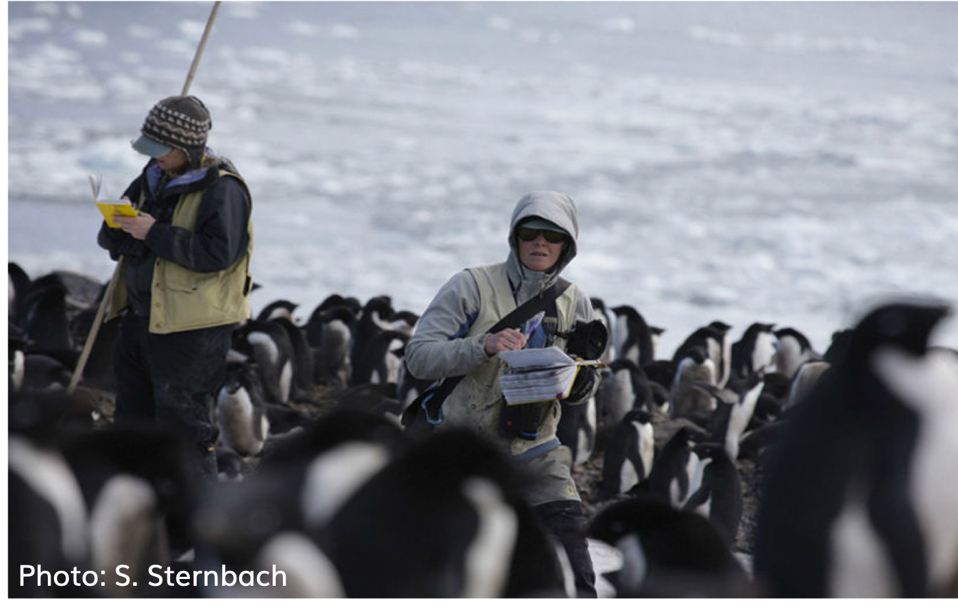
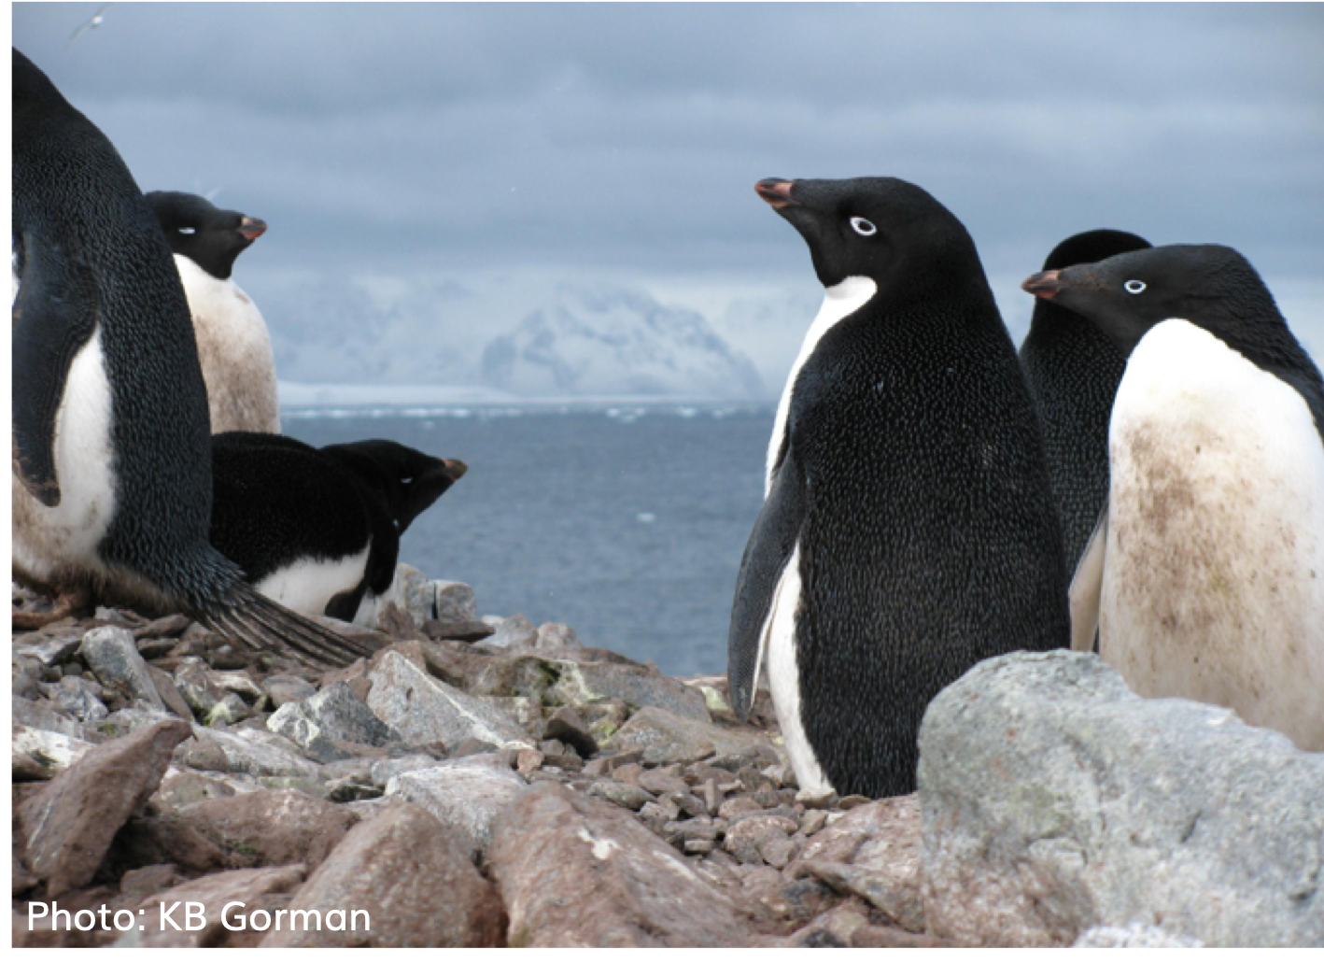
Top: Gentoo penguin colony at Biscoe Point.
Photo: K. Gorman.
Top right: Dr. Kristen Gorman in the field with penguins.
Photo: S. Sternbach.
Bottom right: Adélie penguins. Photo: K. Gorman.

Slide 13
References and Further Reading
https://education.rstudio.com/blog/2020/07/palmerpenguins-cran/
Release the Penguins
Alison Hill, Allison Horst, Kristen Gorman
https://journals.plos.org/plosone/article?id=10.1371/journal.pone.0090081
Ecological Sexual Dimorphism and Environmental Variability within a Community of Antarctic Penguins (Genus Pygoscelis)
Kristen B. Gorman , Tony D. Williams, William R. Fraser
https://towardsdatascience.com/data-analysis-in-python-getting-started-with-pandas-8cbcc1500c83
Data Analysis in python: Getting started with pandas
Author: Kerry Parker (article: Jun 24, 2020)
https://docs.google.com/presentation/d/1DFJLXYRJ2kWw6AFkJu7MclFPr8zkqD-PHh5bs4xcr3Y/edit?pli=1#slide=id.g8caec87945_0_2 (Palmer penguins slides)
All photo credits to K. Gorman and S. Sternbach

